Slide 1
Pronunciation and Accent Corrector
for Communication Devices
Under the Guidance of By-
Prof. M. V. Kamble Saurabh Deshmukh (L-12)
Akash Doifode (L-16)
Rajat Hudge (L-18)
Vyomkesh Shete (L-63)

Slide 2
INTRODUCTION
Importance of Good skill for communication.
Mispronunciation in frequently spoken languages mainly ‘ENGLISH’.
Also stammering problem while speaking is a major problem for communication.

Slide 3
Brain and mouth of a stammerer are not synchronized, but he knows what to say, so if we provide him options, he may be able to select what he wants to say.
The Real-time Application which corrects ACCENT AND PRONUNCIATION while communicating.

Slide 4
SIMPLE BLOCK DIAGRAM
Speech database
Speech to text convertor
Words Start from detected Phoneme
GUI with Conversation in Visual Text form
Text & Phonemes Database
Text to speech convertor in user voice
Input speech
Corrected speech

Slide 5
Speech to Text:
We used two methods for converting speech to text.
1)Using MFCC
2)Using SVM and FFT

Slide 6
(1)Using MFCC
Speech Signal
Preprocessing
Frame Blocking and Windowing
Feature Extraction
Post processing
MFCC
Coefficients

Slide 7
(2)Using FFT and SVM
Speech
Signal
Preprocessing
(Filtering and V/UV Detection )
Frequency Coefficients using FFT
Classified
Output
SVM Classify
SVM Training
FFT Coefficient Bank

Slide 8
Graphical User Interface(GUI)
We have used three GUIs,
1)Main Project GUI,
2)Training GUI,
3)Add New Word GUI.

Slide 9
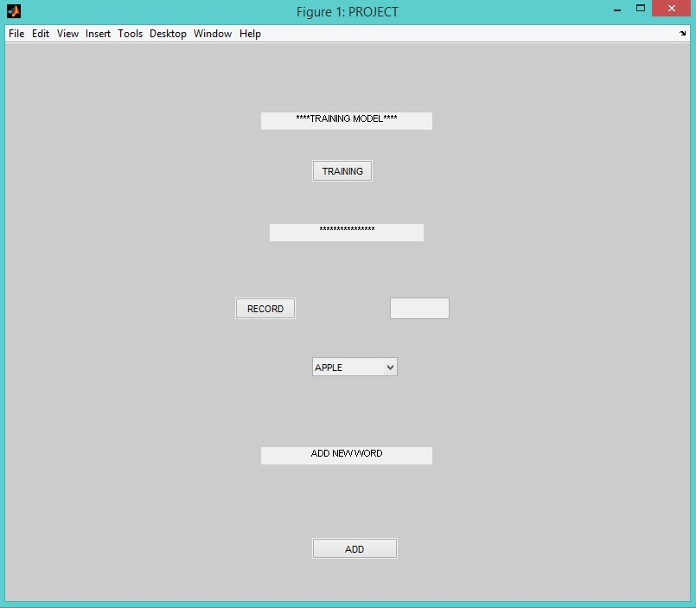
1)Main Project GUI

Slide 10
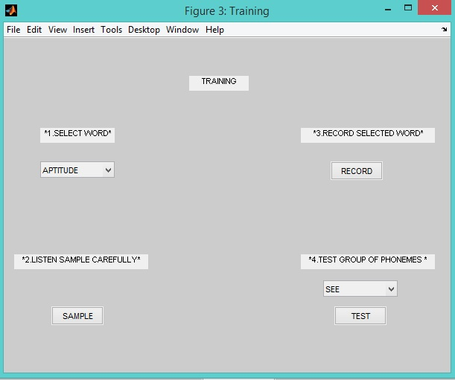
2)Training GUI

Slide 11
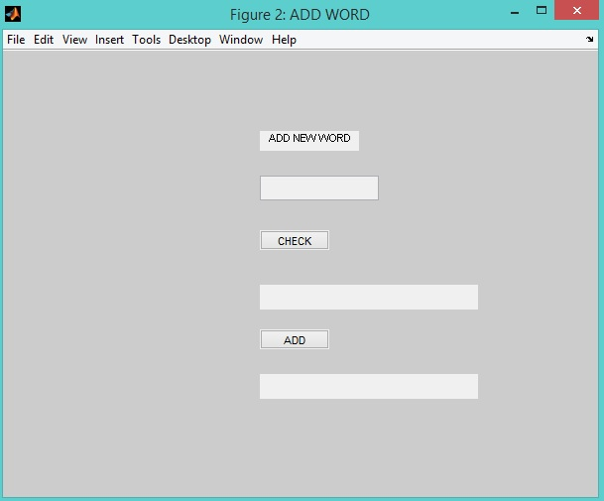
3)Add New Word GUI

Slide 12
TEXT TO SPEECH CONVERSION
Input Text
Text Analysis & Text Detection
Text Normalization & Text Linearization
Phonetic Analysis
Acoustic Process
Prosodic Modeling & Intonation
Speech as Output

Slide 13
Concatenative Speech Synthesis – un-natural
synthesis
It is reverse process of speech to text conversion.
This conversion is brought out by use of 44 phonemes in English language.
Input Text is first converted in phonetically analyzed text.
ex. Girl g/ur/l

Slide 14
Using Group of Phonemes:
Using phonetic concatenation,
Multiplication=m/ul/t/ee/p/l/ee/ke/sh/n
Using group of phonemes,
Multiplication=mul/tee/plee/ke/tion
In phonetic concatenation, binding gap between phoneme is more, so we used group of phonemes approach which helps in reducing the binding gap and gives desired result.

Slide 15
Future Scope:
1)Voice Morphing:
Voice morphing is a technique for modifying a source speaker’s speech to sound as if it was spoken by some
designated target speaker.
The Technology modifies the pitch, speed, tone and other key attributes of voice to according to correlation between two voices.

Slide 16
BLOCK DIAGRAM
Speaker’s voice
Accent Database
Spectral Detail
Spectral Detail
Morph correlator and modifier
Speaker’s voice with corrected accent

Slide 17
2) Hidden Markov Model:
The technique used in the implementation the speech recognition system was the statistical one, Hidden Markov model, HMM.
Best when working with speech processing.
In the HMM design there is a need for solving the three fundamental problems, the evaluation, determination and the adjustment.

Slide 18
DRAWBACKS
Time-delay in process.
Change in characteristics of speech according to speaker’s emotions are not reflected in output speech.
Large Database required in system.
It can be misused to extract passwords, change voices etc.

Slide 19
Applications:
It can be helpful for those people who have stammering problem.
Useful for people having dull accent and bad pronunciation.
Can be used in BPOs, call centers.

Slide 20
Thank You…..1111

